Slide 1
Siya Incorporated
Empowering the nation:
Application and website presentation

Slide 2
Who are we?
Siya Inc. is a company that specialises in Mobile app and web dev
3 man team that was tasked with handling this project

Slide 3

I am Loyiso Motsamai
I was tasked with the design and colour scheme
I was also tasked with creating the structure and style of code

Slide 4
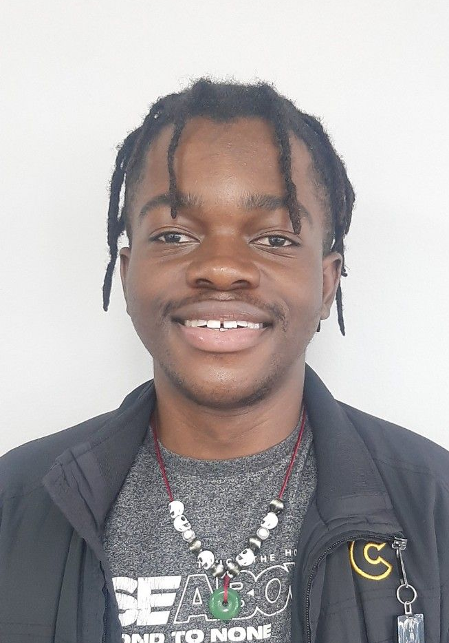
I am Simphiwe Siyanda Thembeni
I was tasked with managing the structural design
Another job of mine was to handle strategic administration

Slide 5
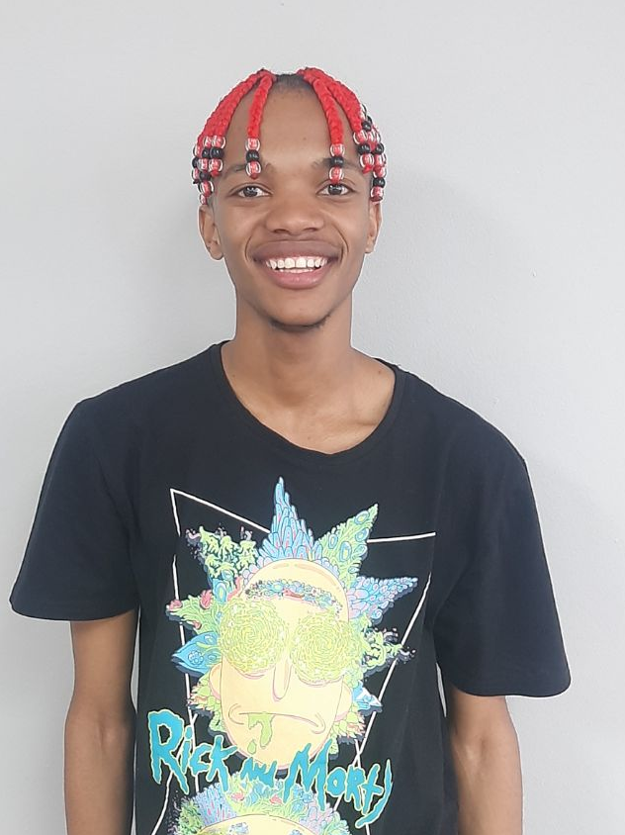
I am Goitseone Kananelo motuba
I was the user interface and user interaction architect
I was also responsible for functionality and per

Slide 6
Who is our client?

Slide 7

Precious Radebe
CEO of a mid-sized enterprise called Empowering the Nation
They needed a website and application to better allow potential clients to access these skills and courses

Slide 8
What is empowering the nation?
Empowering the nation is an initiative (started in 2019) that provides skills and training
Precious's parents and elder relatives did not have opportunities to upskill in formal settings
The school will give customers the opportunities to start their own businesses with the skills learned
Many employers would also like for their employees to have many skills and qualifications

Slide 9
Desires from the client
A website and application that reflects the professional image and purpose
A logo that also reflects these values
The website and application should also be easy to use and accessible to users
Products should also display the plethora of courses other courses

Slide 10
Project requirements
An application and a website
Both the application and website must maintain familiar experience
Should allow users to sign and receive discounts for doing multiple courses

Slide 11

The Design Process

Slide 12
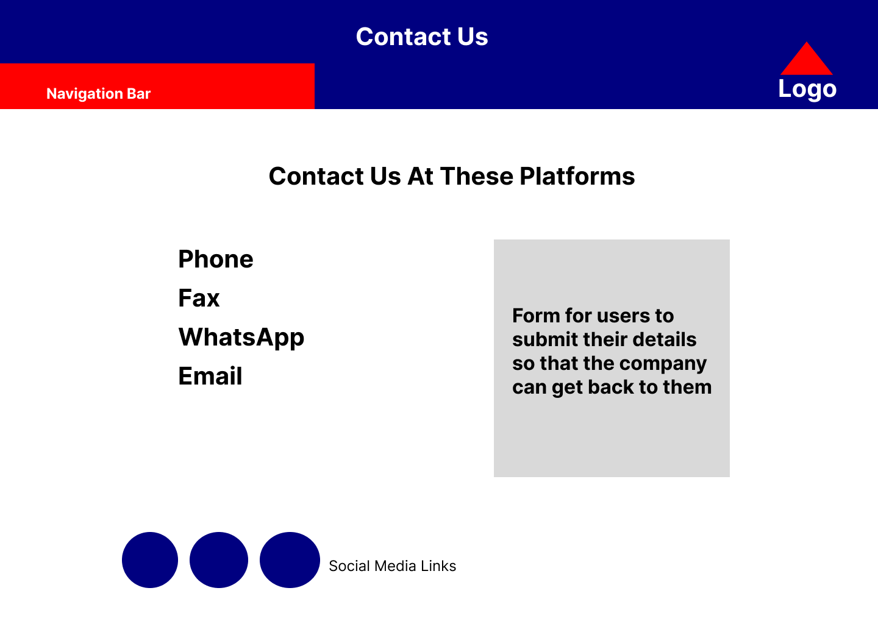
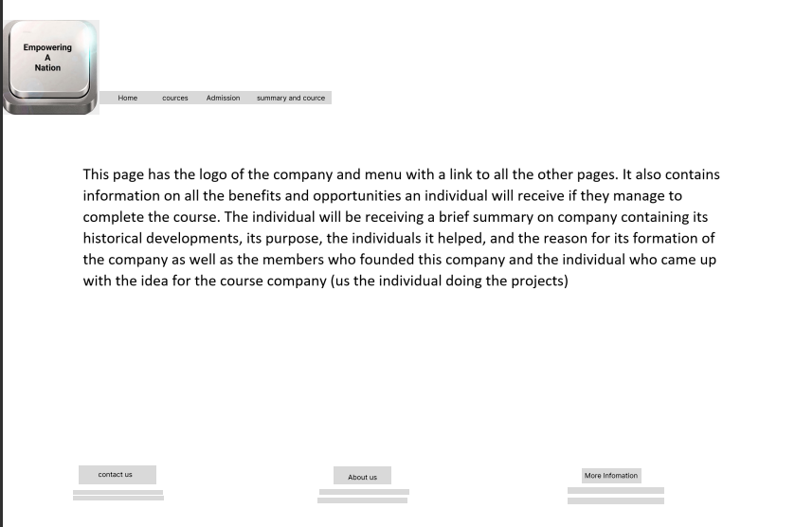
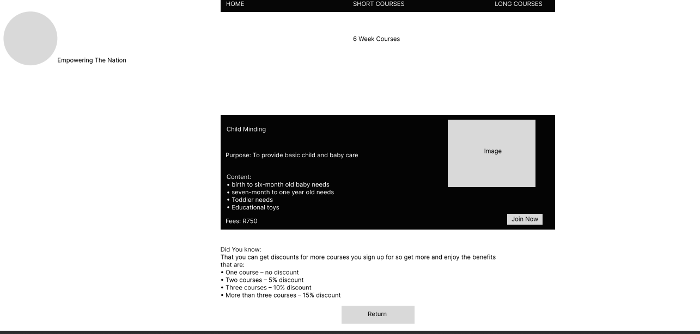
Initially 3 different designs combining
Black and white colour scheme
Simplistic, easy to use
Vibrant, eye catching, addicting feel to the product
Simplistic, analytic, functional
Ease of use, familiar use on both plaforms

Slide 13

Culmination of the 3

Slide 14
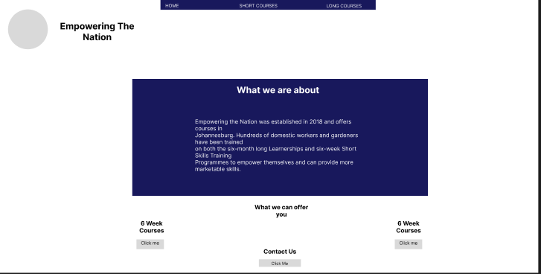
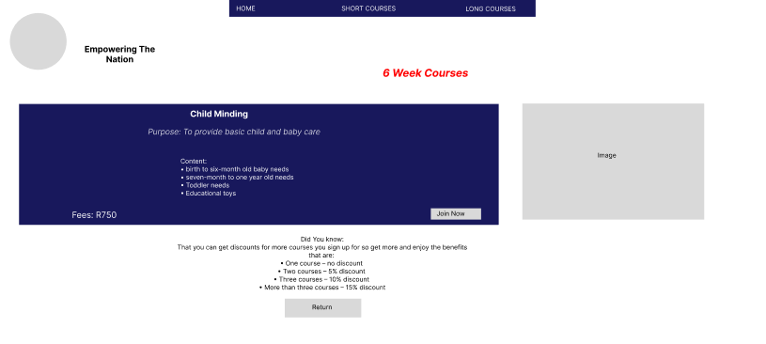
New design direction
Some structure and functionality from Siyanda
Colour scheme, fonts, Placements from Loyiso
Functionality and implementation from Kananelo

Slide 15
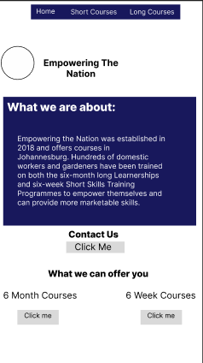
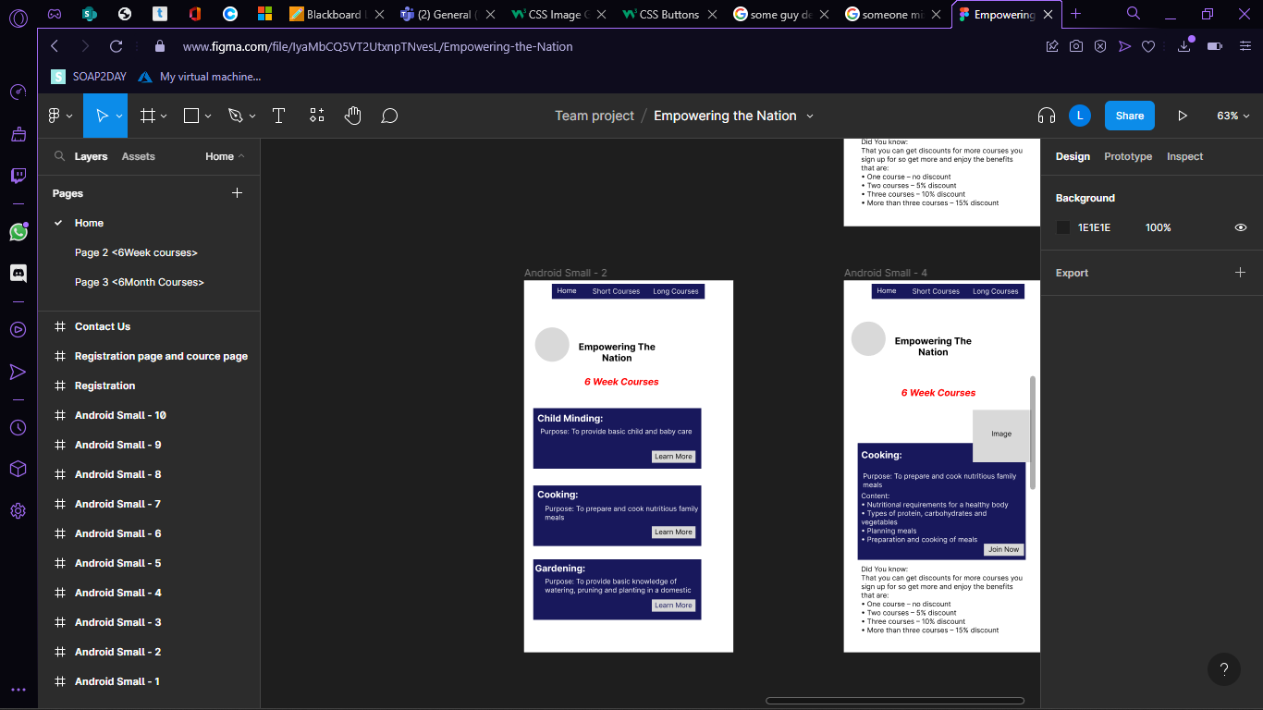
Same for the application

Slide 16

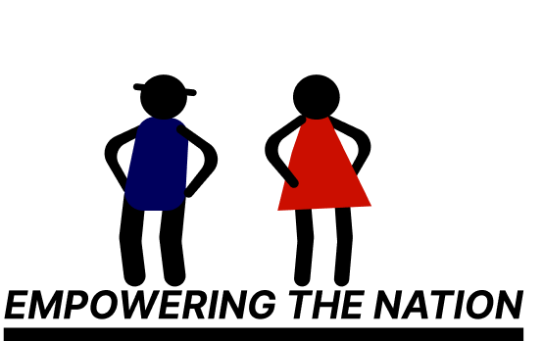
Logo design and explanation
Colour scheme represents clients family
Logo maintains the main and purpose of the organisation
Represents the people
Smaller logo fits into the products

Slide 17
Website showcase

Slide 18
Application showcase

Slide 19
Questions

